Slide 1
Unrolling algorithms for tomography of limited angles
Group component:
Kamal Nishantha Angunna Gamage
Matteo Fontana
Giuseppe Spathis
Supervisor:
Elena Loli Piccolomini

Slide 2
Project description
Goal: Reconstruct CT images from limited-angle sinograms using an unrolling method (Adler et al.) with a Residual U-Net architecture.
Comparison: Evaluate the unrolling Plug-and-Play algorithm against a Total Variation (TV) model-based reconstruction and Filtered Back Projection (FBP).

Slide 3
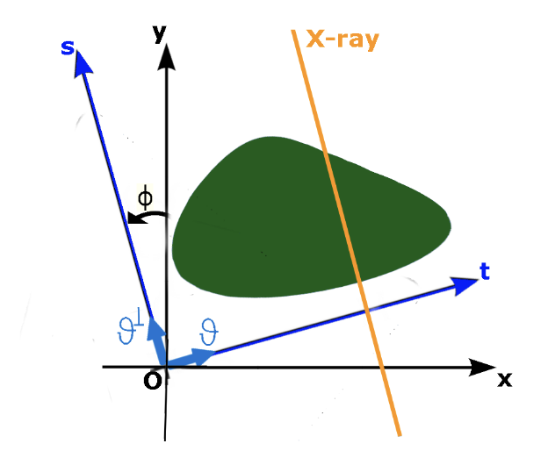
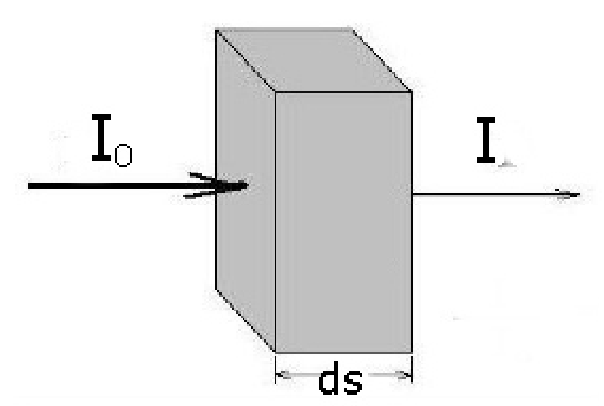
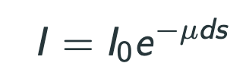
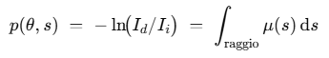
Theory Introduction

Slide 4
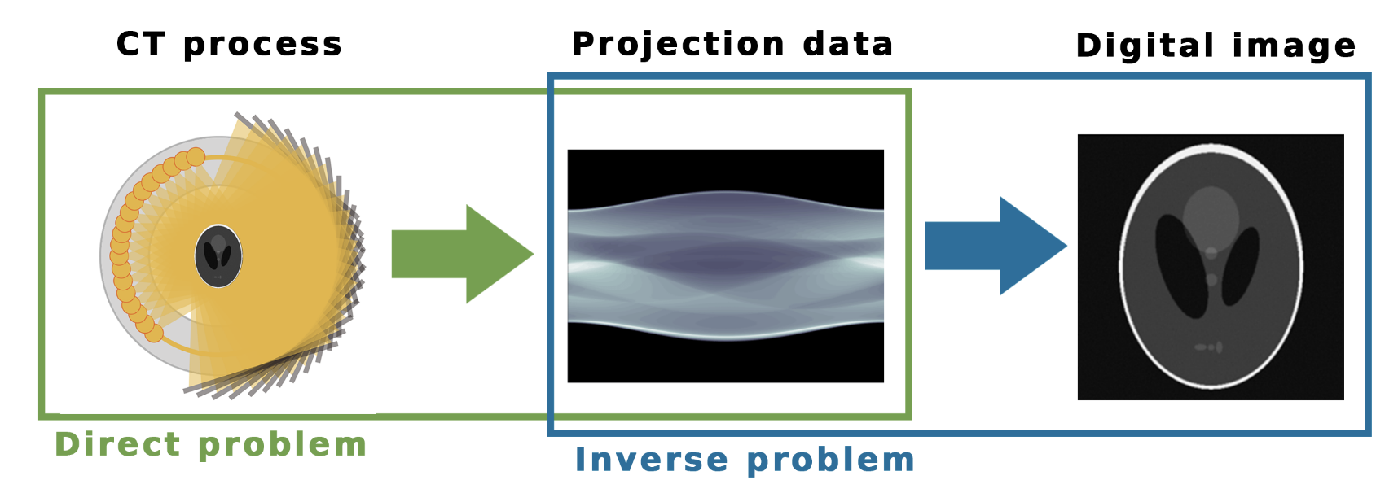
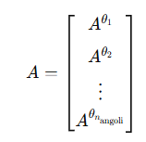
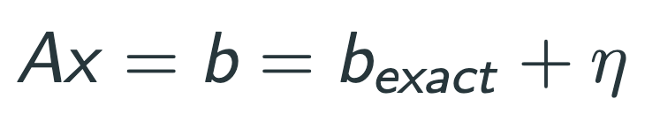
Problem description

Slide 5
Methodology
We have compared 3 algorithms:
Filtered Back Projection.
Total Variation regularization.
The unrolled method: Learned-Primal dual.

Slide 6
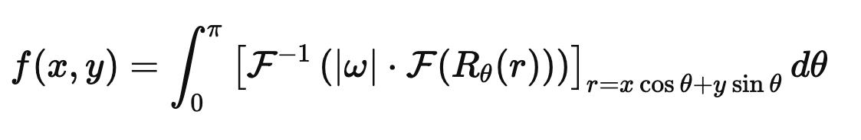
FBP - Theory
FBP (Filtered Back Projection) is a direct method for image reconstruction from sinograms (Radon projections).
Rθ​(r) is the Radon transform (i.e., projection at angle θ)
F and F−1 are the Fourier and inverse Fourier transforms
∣ω∣ is the ramp filter in the frequency domain (or other filters like Shepp–Logan, Hamming, etc.)
This formula:
Filters the sinogram in frequency domain (amplifying high-frequency components).
Back-projects the filtered projections over the image domain.
Fast and non-iterative, but sensitive to noise and artifacts.

Slide 7

FBP - Implementation
Function used: skimage.transform.iradon
Input: sinogram
Main parameters:
theta = geometries
filter_name = "ramp" (Ram-Lak filter)
Output: reconstructed image using inverse Radon transform.

Slide 8
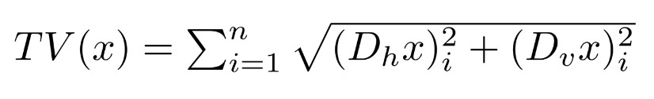
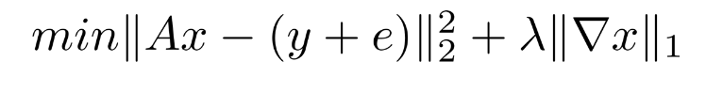
TV - Theory
Enhance image reconstruction by preserving edges while removing noise.
Total Variation is defined as:
Solves problems of the form:

Slide 9
TV - Implementation
Optimization Algorithm: ISTA (Iterative Shrinkage-Thresholding Algorithm)
Step Size (Learning Rate): 0.005
Regularization Weight(lambda_tv): 0.05 (tuned for balance between data fidelity and smoothness)
Proximal Operator: Chambolle-Pock
Number of Iterations: 1000
Initial reconstruction: np.zeroes_like(img_size)

Slide 10
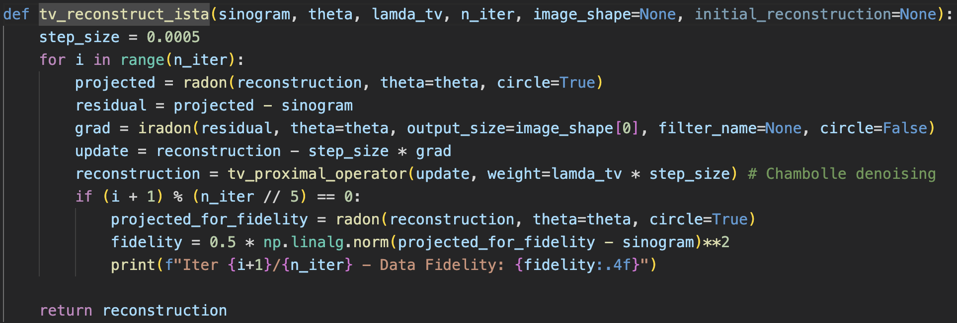
TV - Code

Slide 11
LPD - Theory
Primal Space contains the reconstructed image
Dual space contains the sinogram
In our case, we use 10 unrolled iterations, and for each iteration we have two U-Nets:
- a primal U-Net, designed to denoise the image
- a dual U-Net, responsible for correcting the reconstruction to ensure fidelity to the sinogram.

Slide 12
LPD - Implementation
Hyperparameters:
- Learning rate: 10^-3
- Number of unrolled iteration: 10
- Epochs: 20-30
Batch size: 4

Slide 13
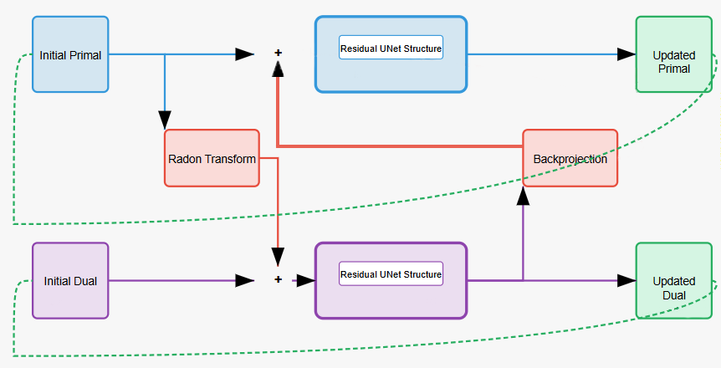
LPD DESIGN
Each U-Net consists of two layers, with 32 features in the first and 64 in the second, and includes residual blocks between them.
Total params: 7,555,860
Trainable params: 7,555,860
Non-trainable params: 0

Slide 14
Introducing the experiments
Test Geometries:
30 angles in [-30°, 30°]
30 angles in [-15°, 15°]
30 angles in [0°, 180°]
Each tested with and without noise (noise level = 0.1)
Metrics:
Relative Error (RE)
PSNR
SSIM
Outputs:
Reconstruction results for a selected image, with zoom-in area visualizations
Average metrics across a subset of the test set, presented in a .xlsx file

Slide 15
Mayo dataset
Provided by the private U.S. institution Mayo Clinic through the Cancer Data Access System (CDAS) of the National Cancer Institute.
It contains 3,305 anonymized grayscale CT images (512×512 px) of human lungs from 10 patients.
Dataset: Mayo Clinic CT Dataset

Slide 16
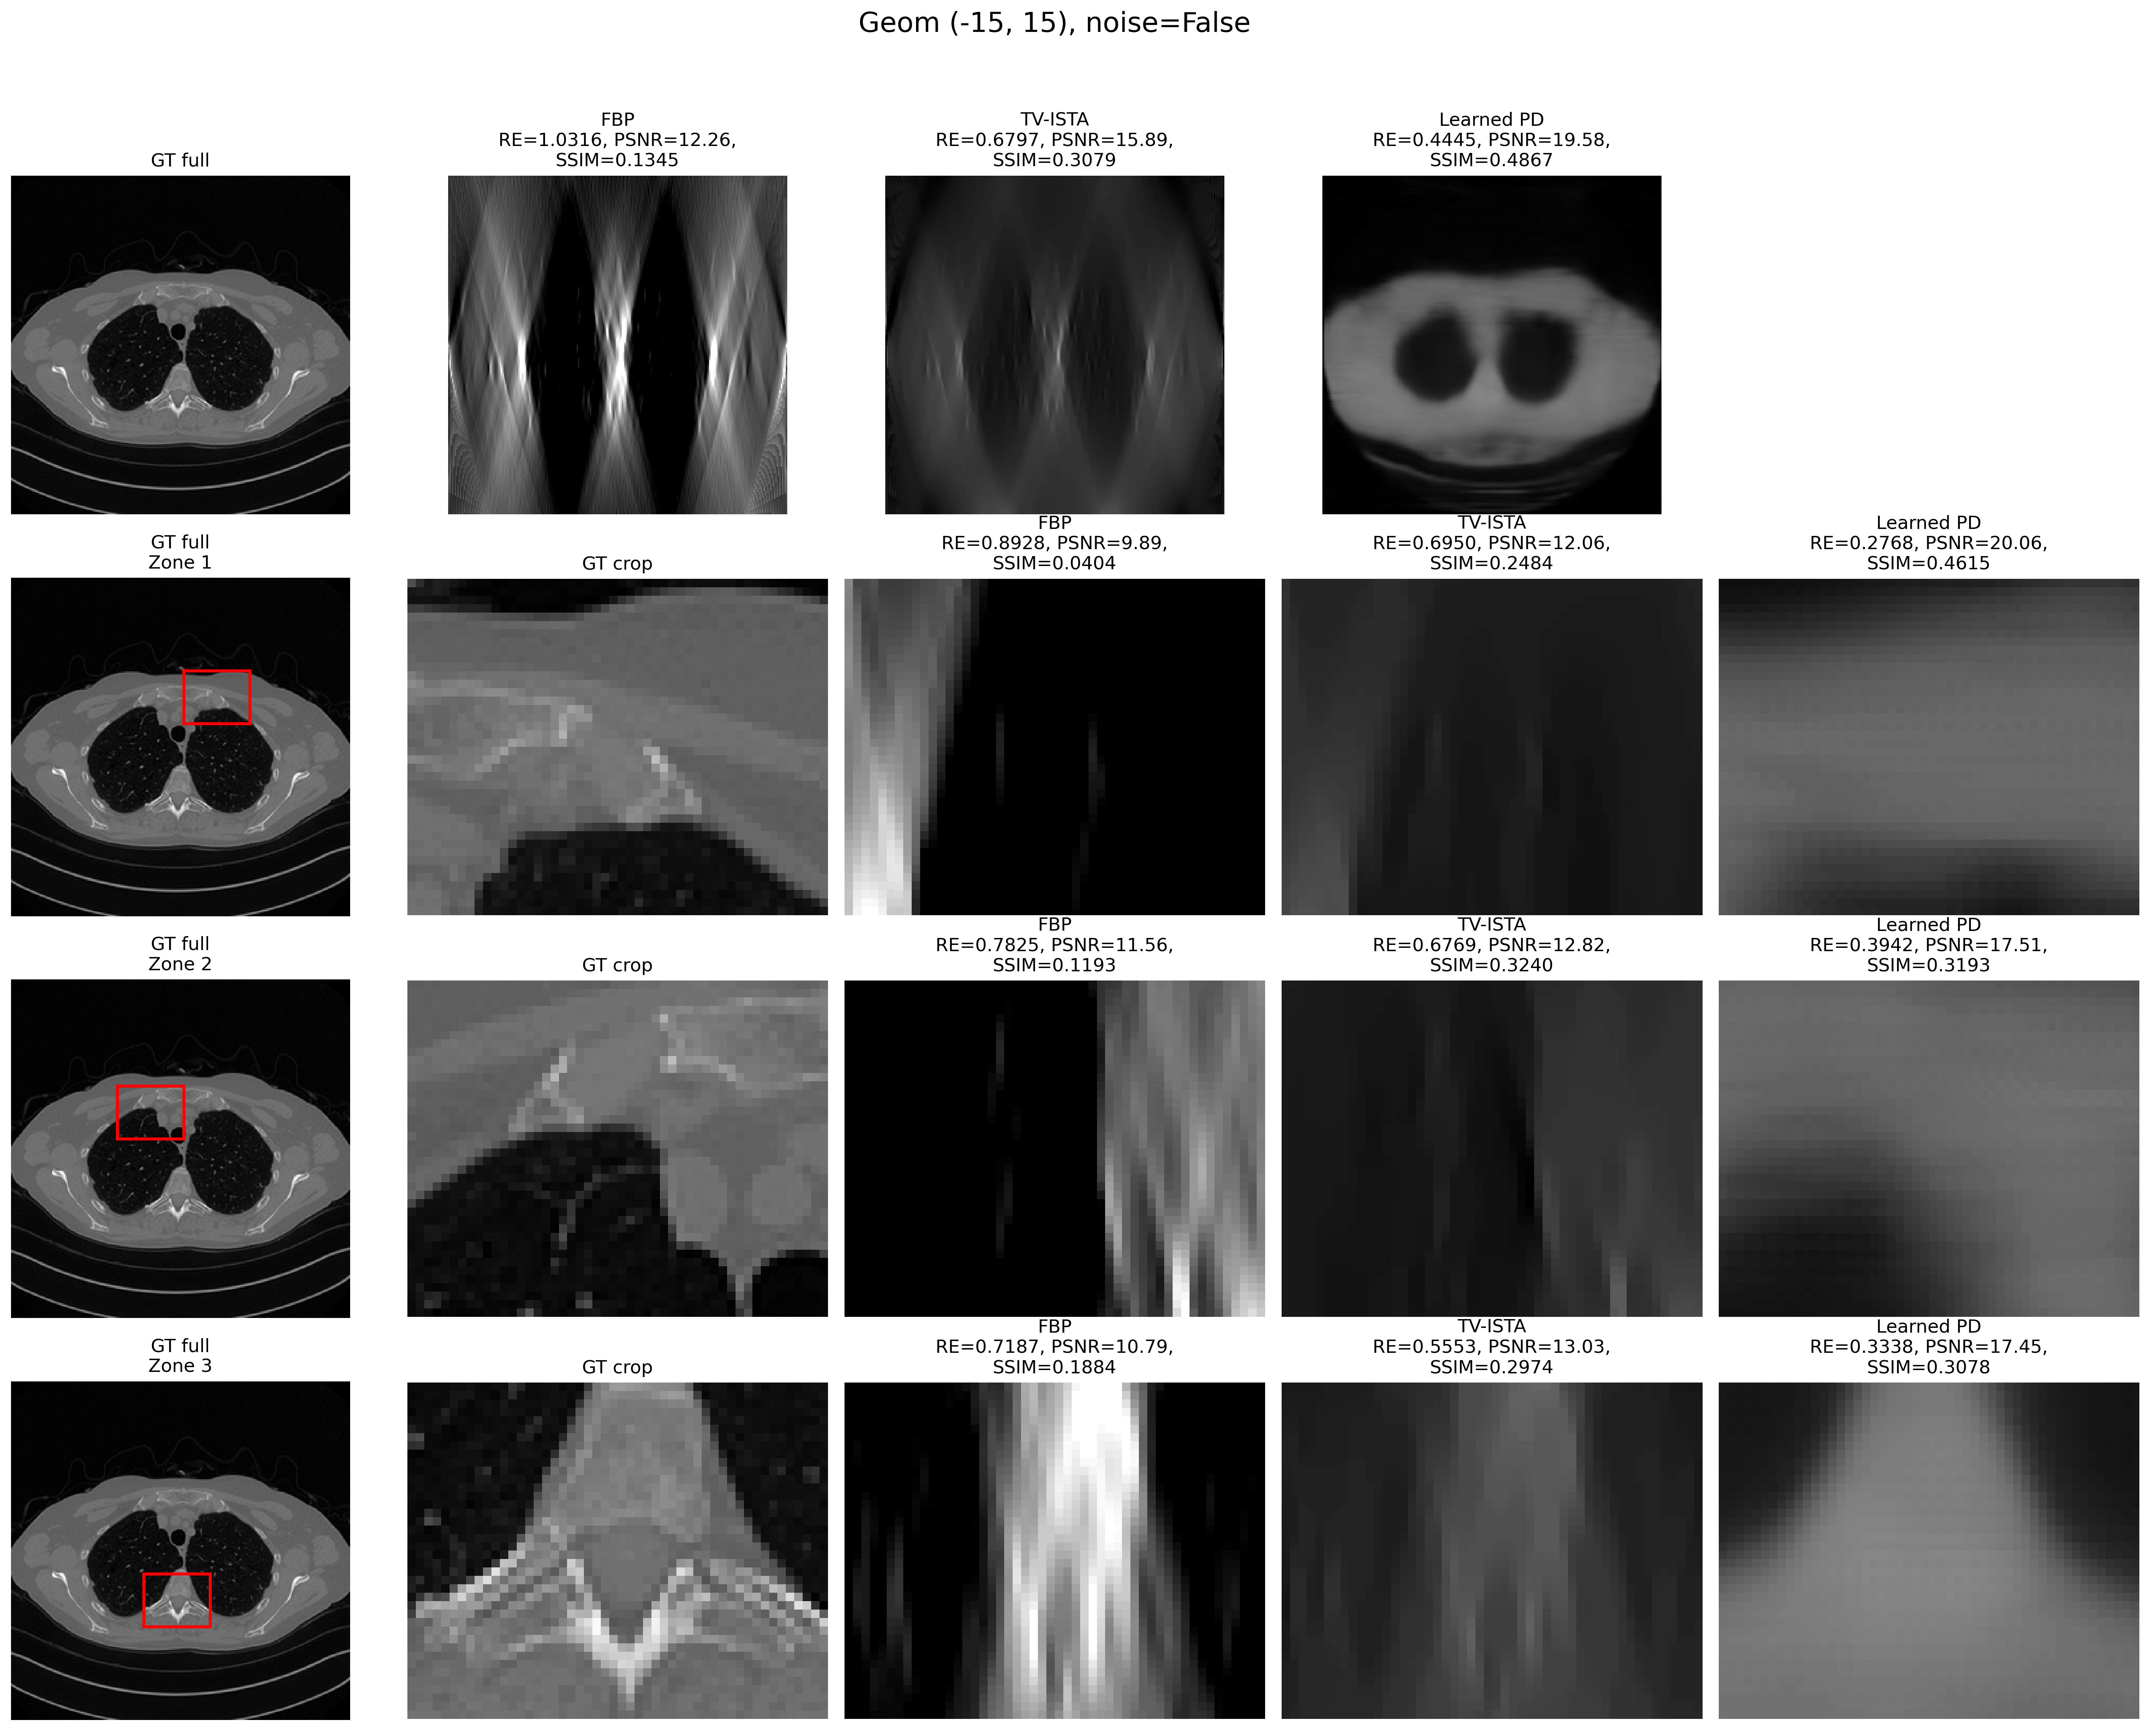










Geom (-15°, 15°)
Noise = False

Slide 17
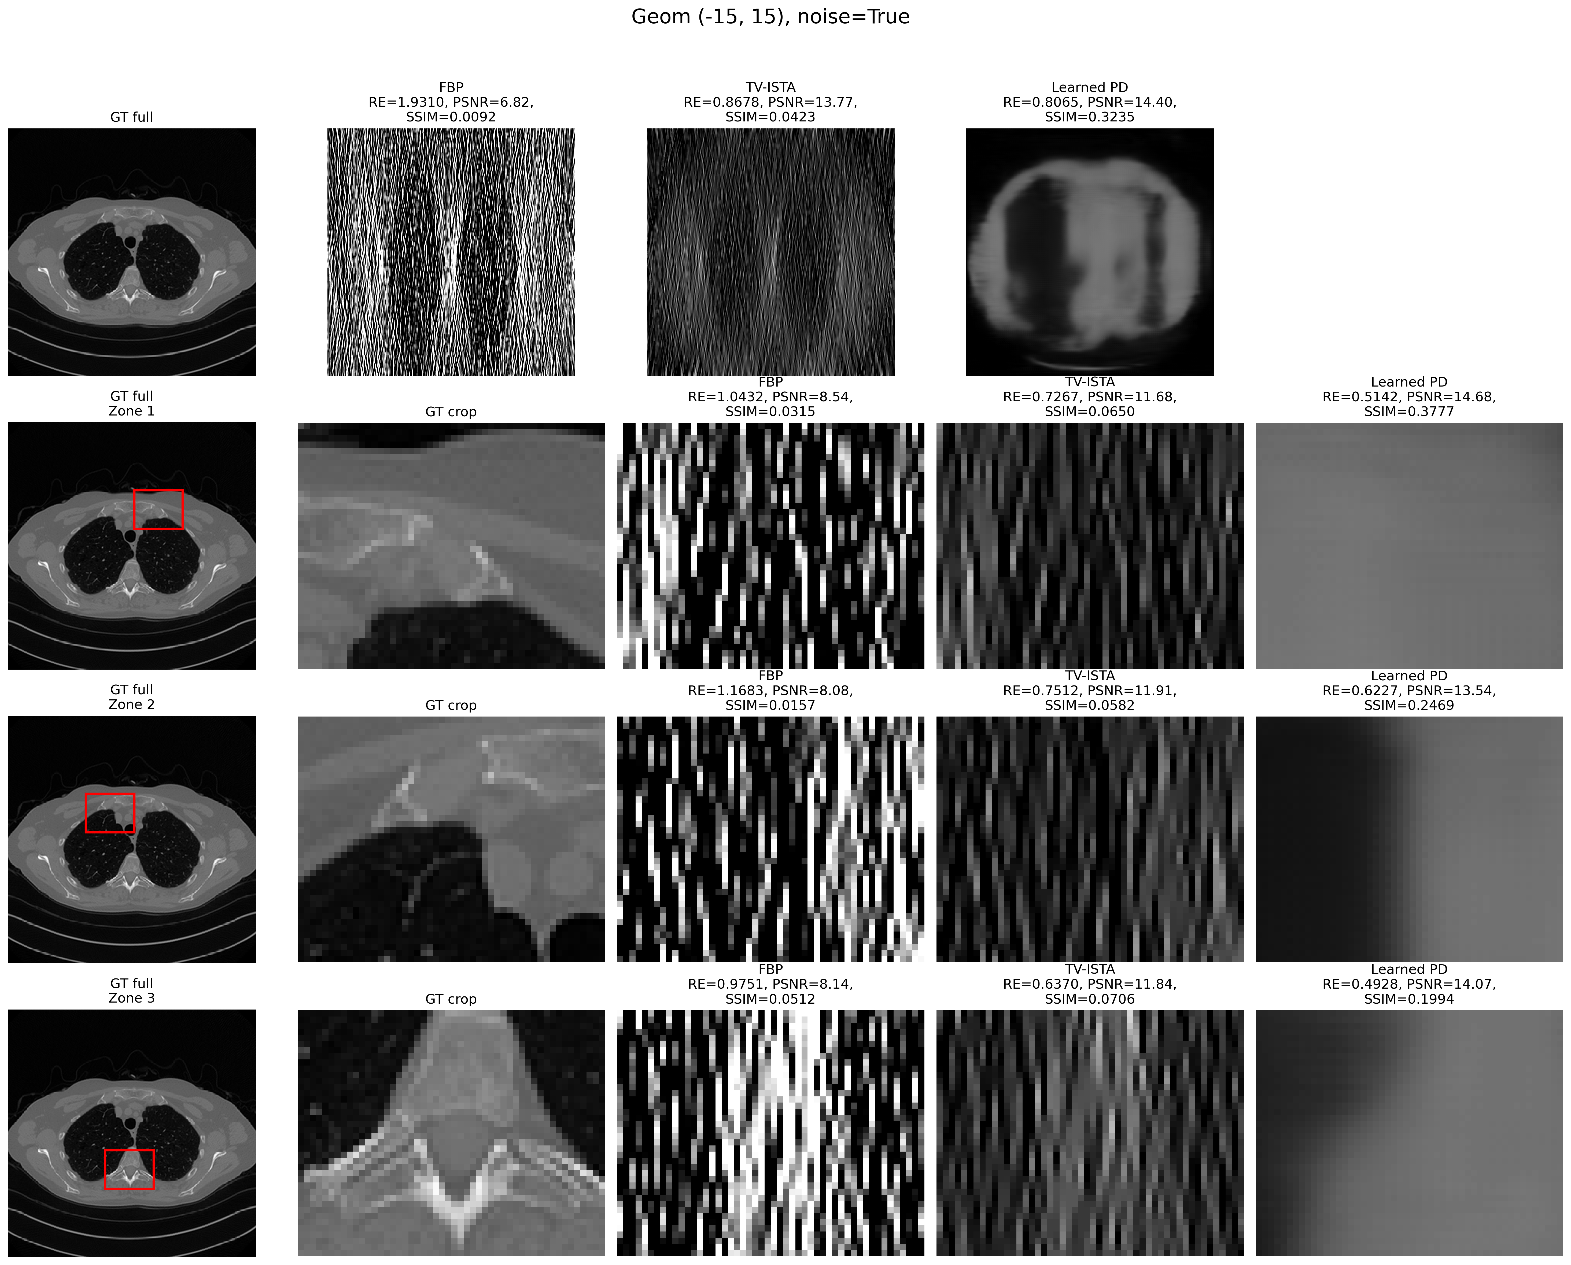











Geom (-15°, 15°)
Noise = True

Slide 18
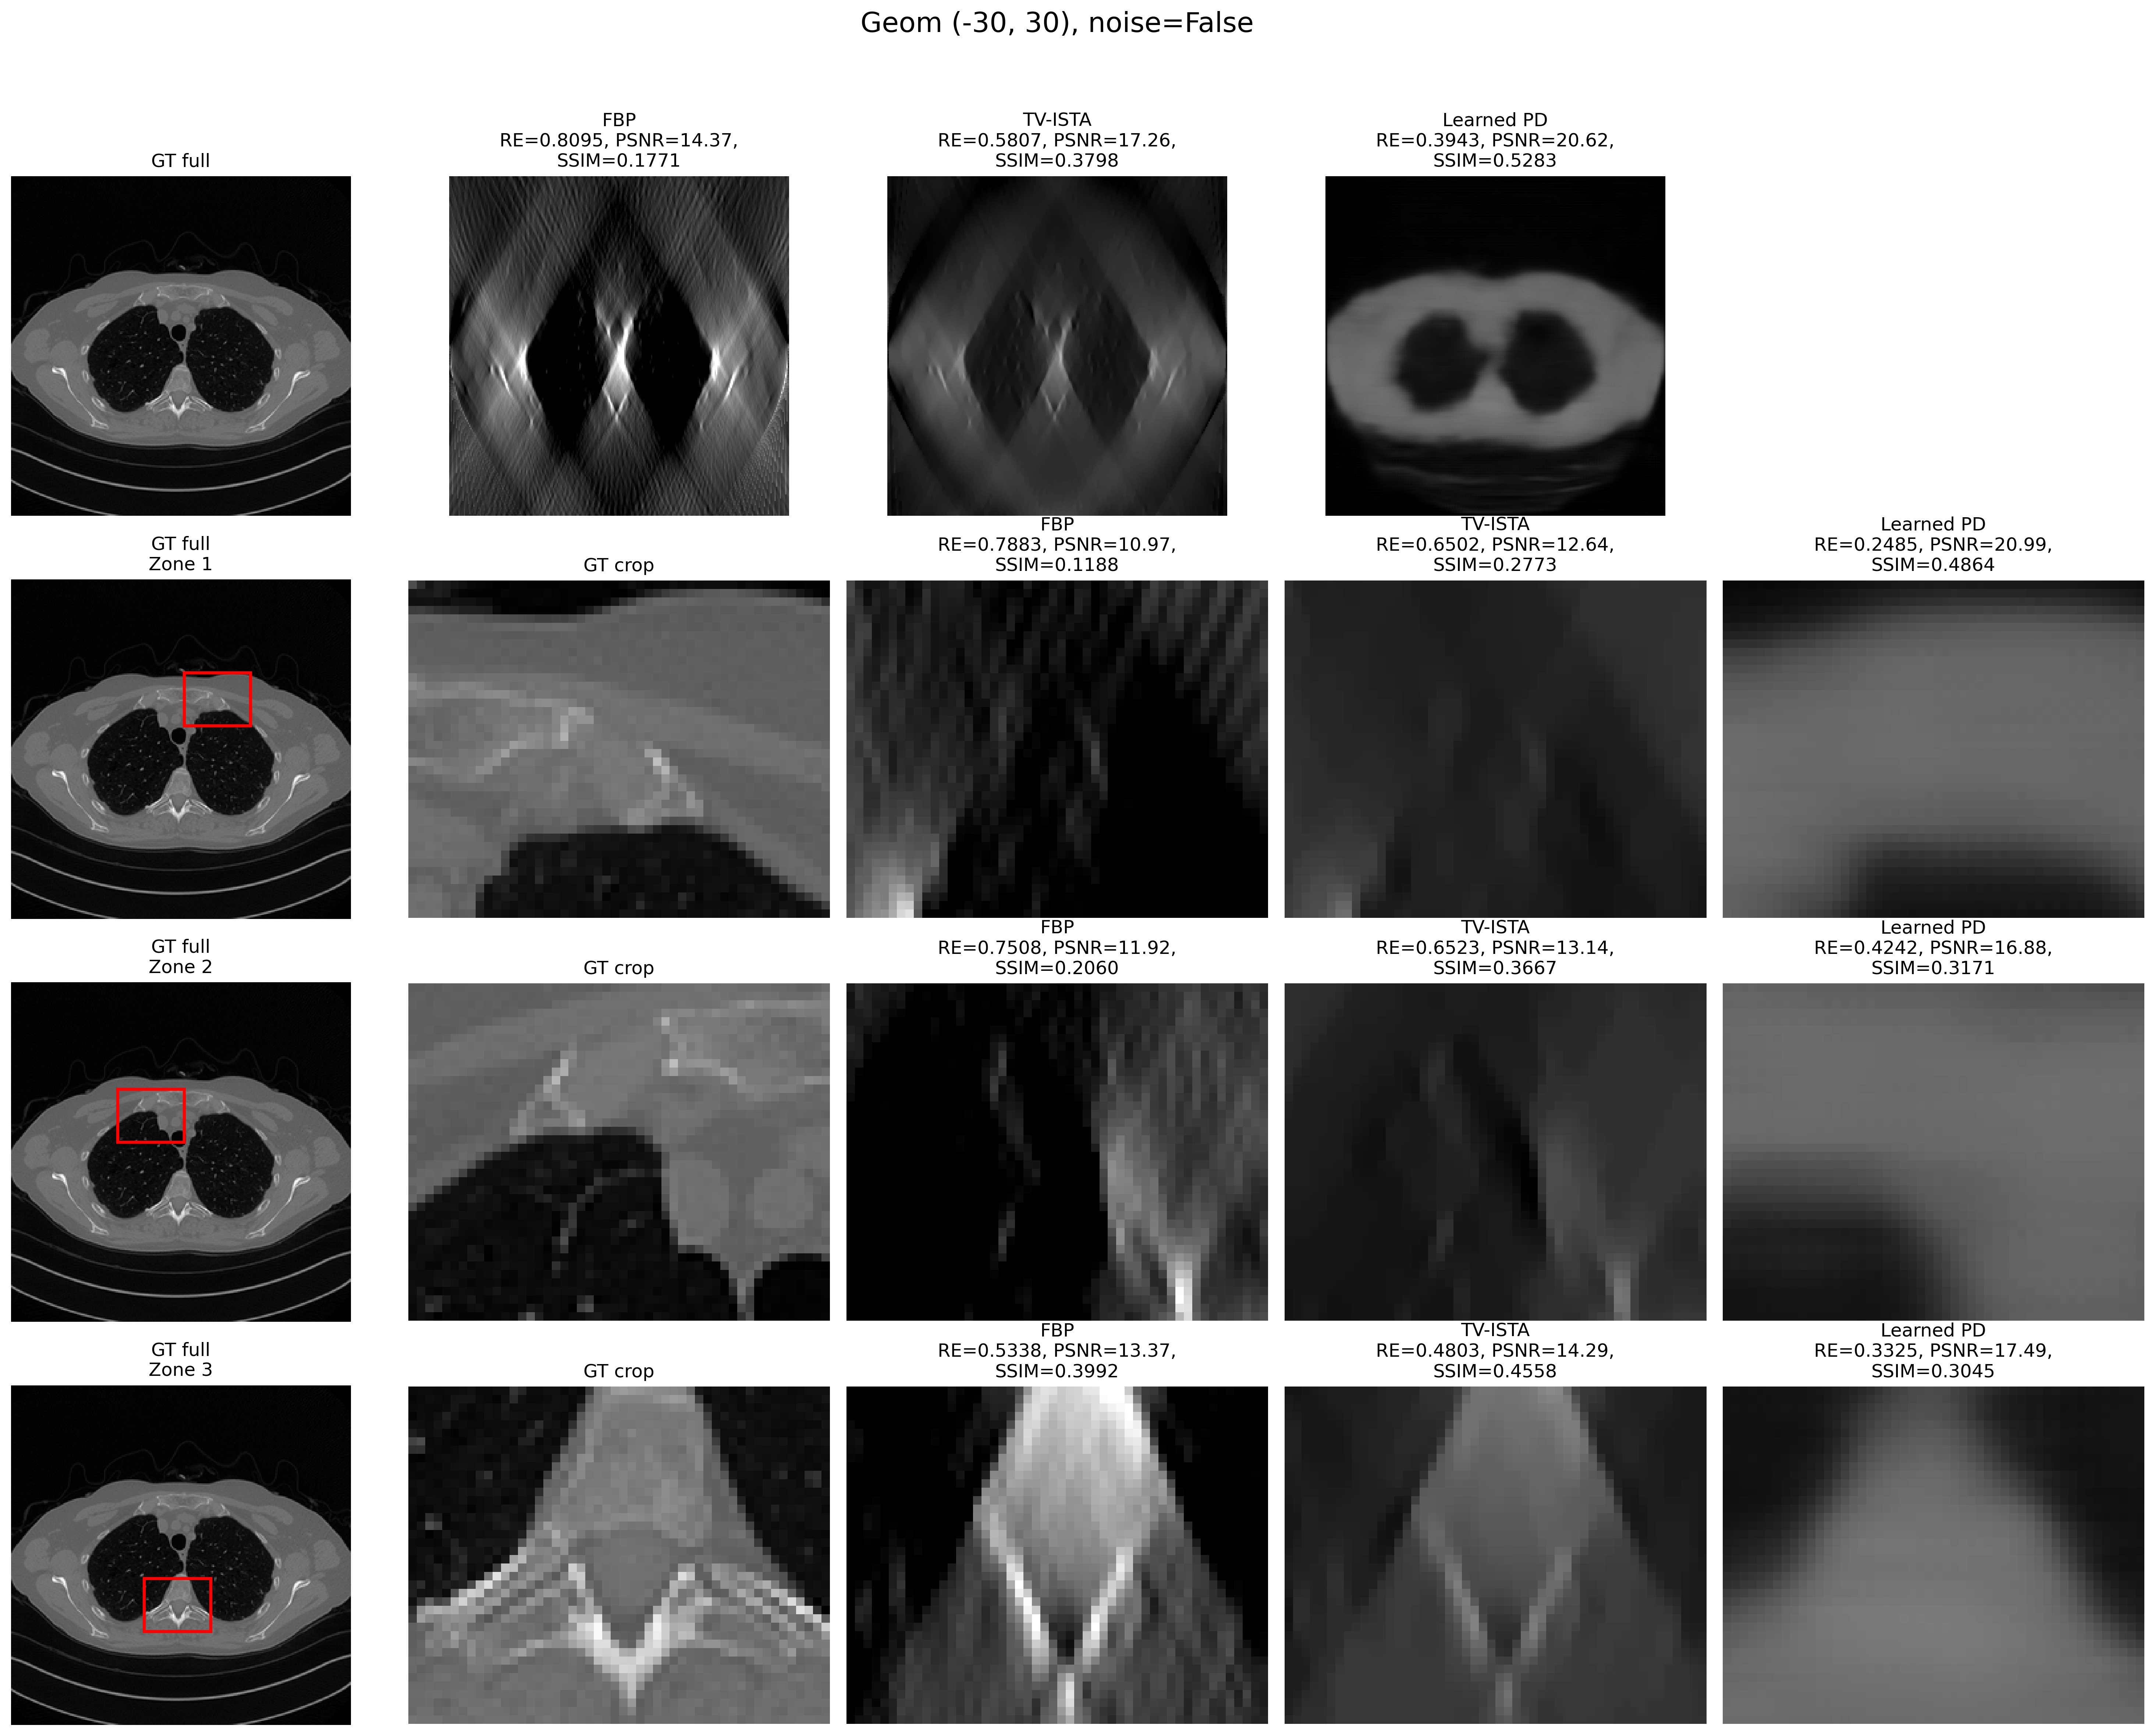












Geom (-30°, 30°)
Noise = False

Slide 19
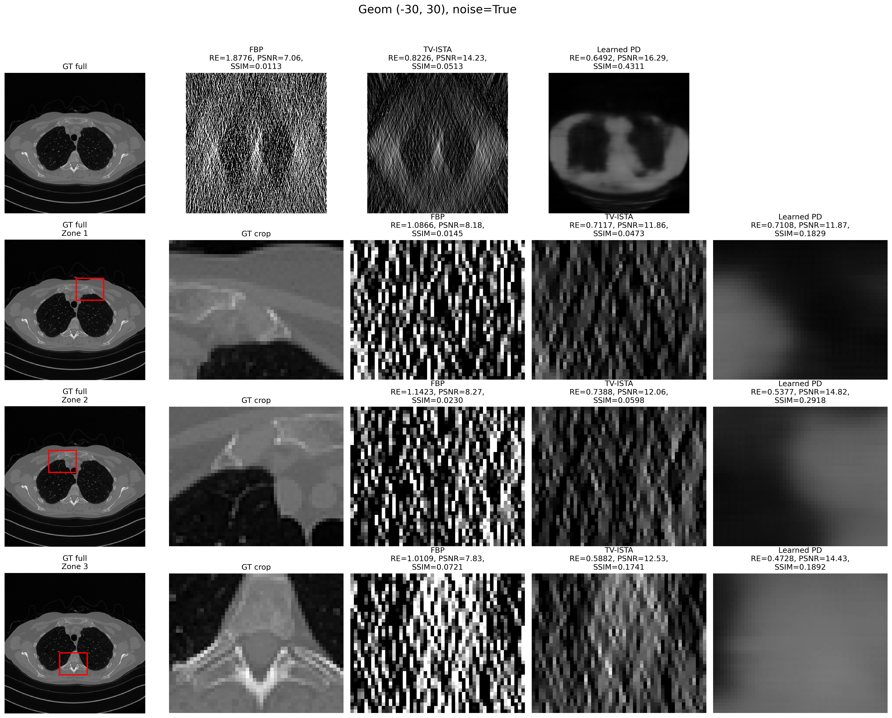











Geom (-30°, 30°)
Noise = True

Slide 20
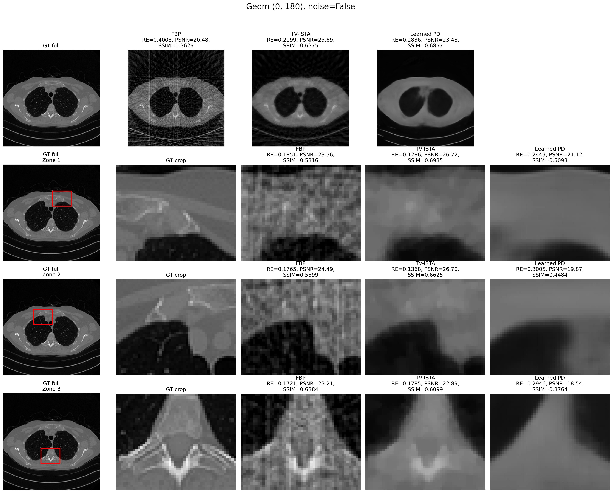











Geom (0°, 180°)
Noise = False

Slide 21
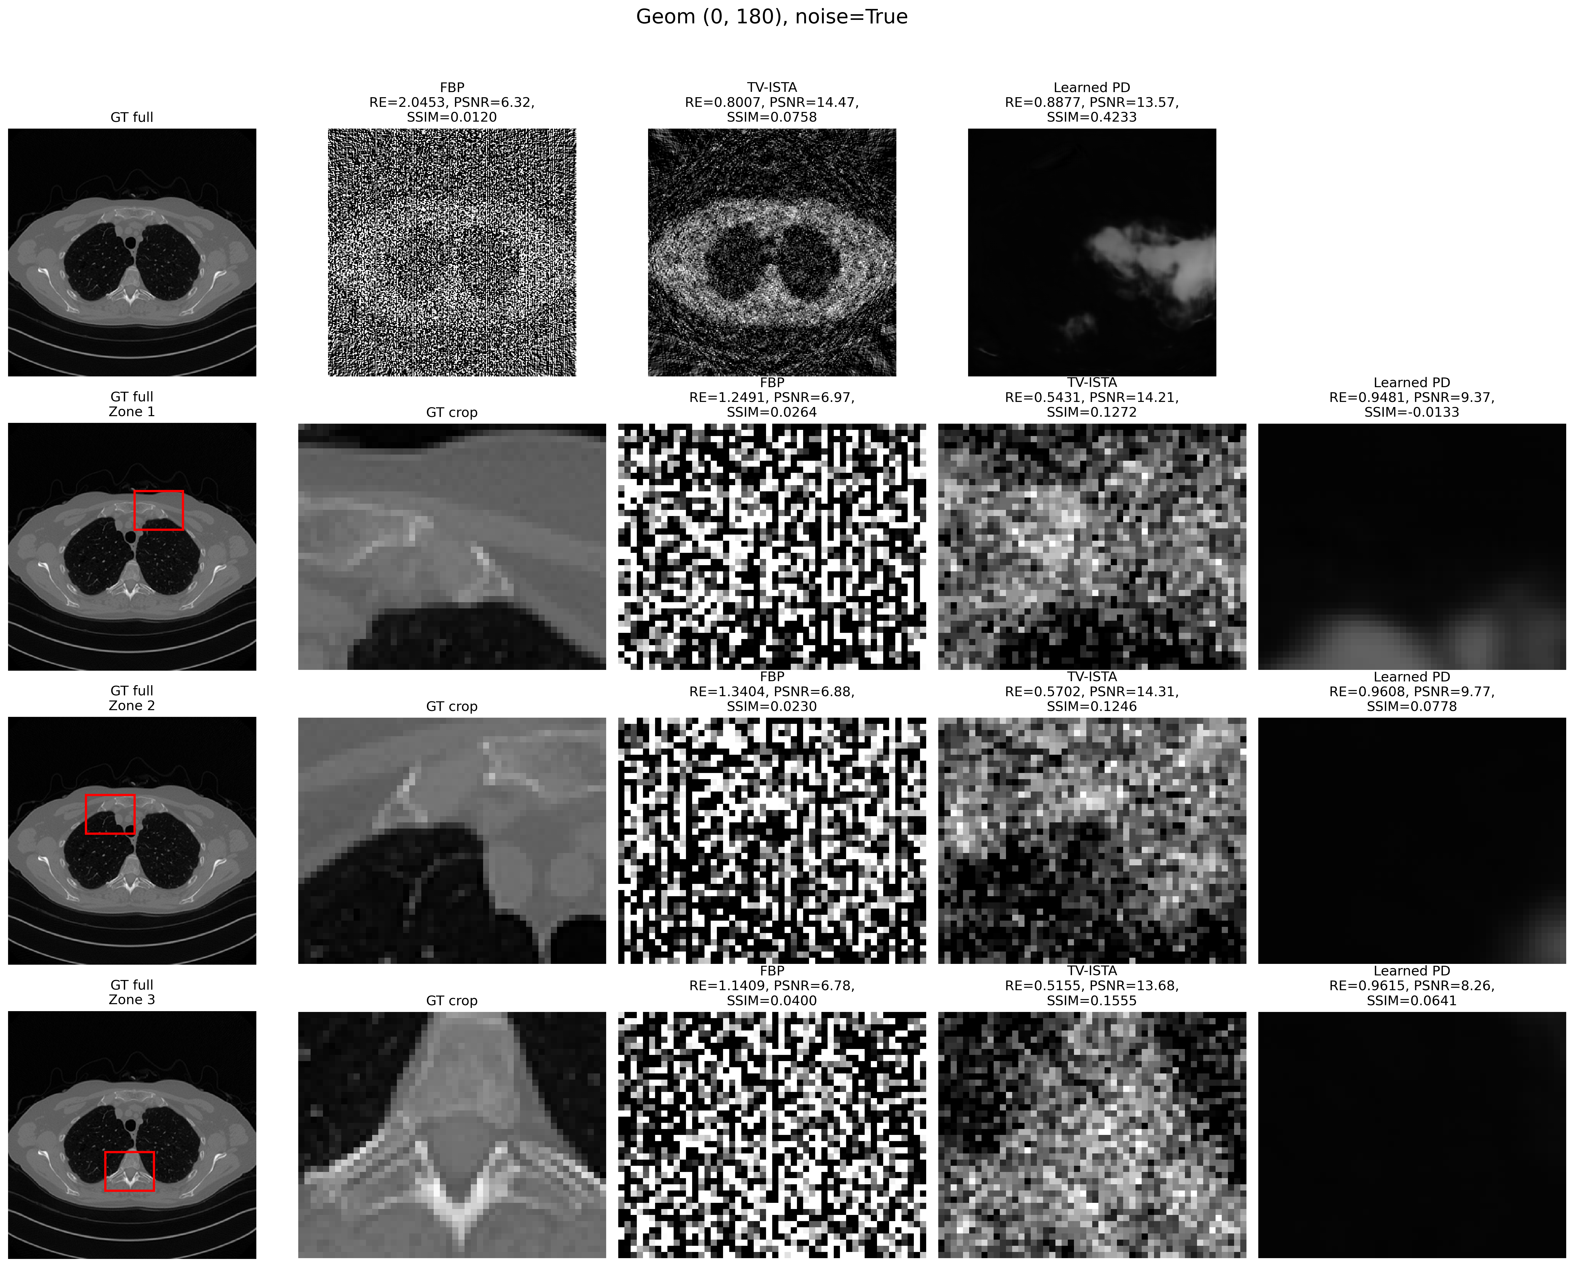












Geom (0°, 180°)
Noise = True

Slide 22
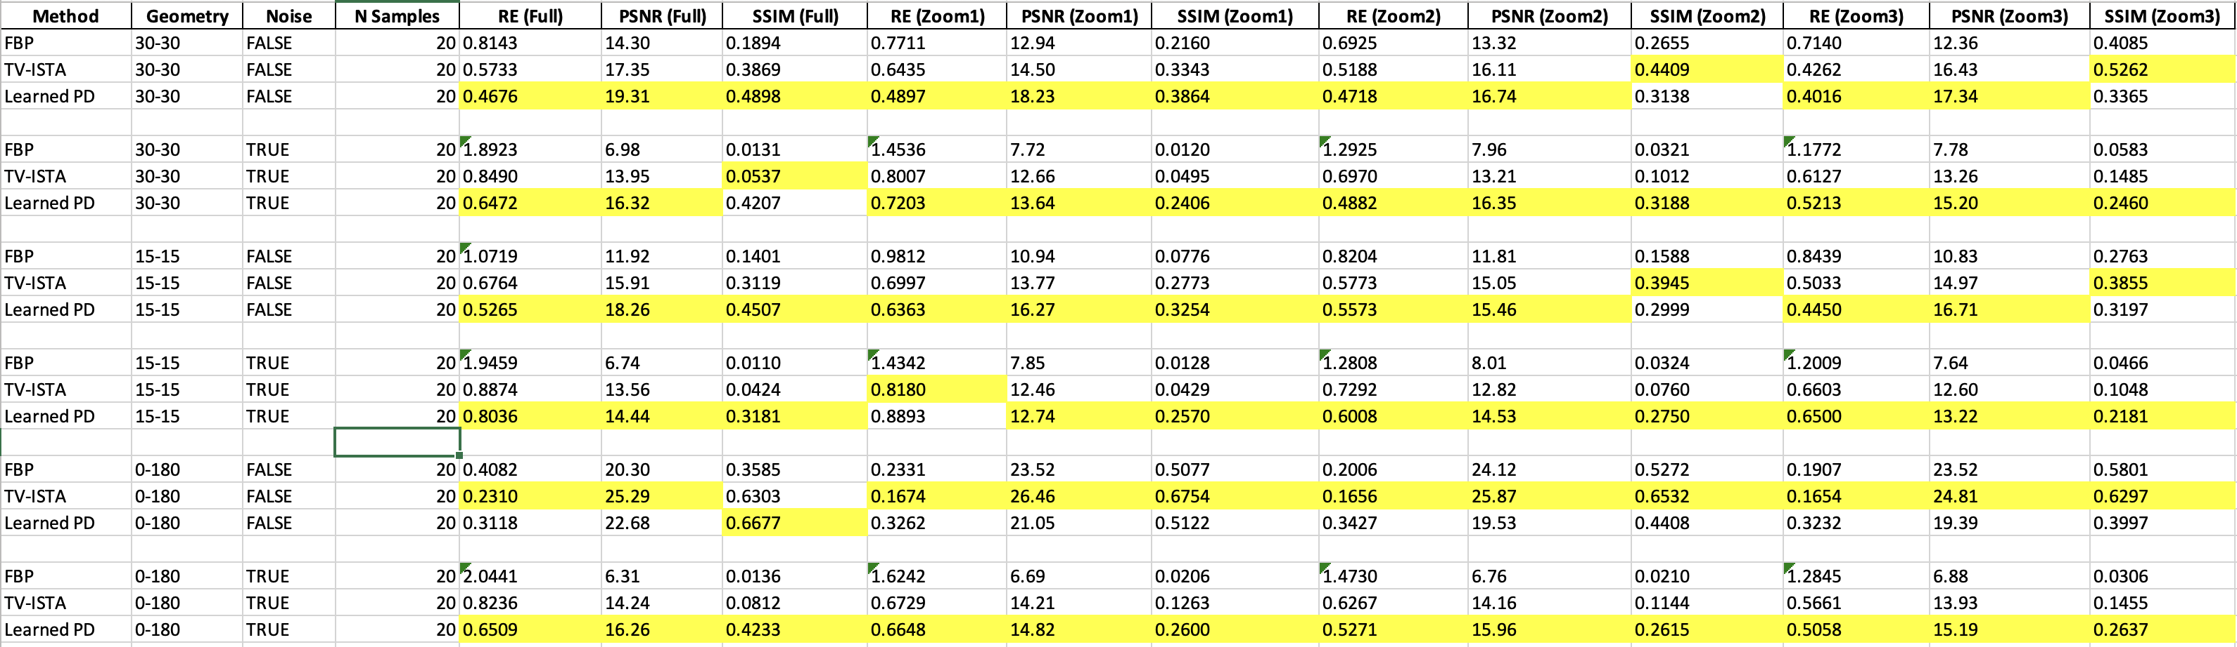
Results on a subset of the test set

Slide 23
Conclusions
FBP:
Worst performance overall
Very sensitive to noise
The fastest method
LPD:
Best performer for ±15°, ±30° geometries
Robust to high noise levels
Outperforms TV on noisy images in the 0°–180° range when analyzing a subset of the test set
May need longer training to fully exploit wide angular ranges (e.g., 0°–180°)
TV regularization:
Sometimes achieved higher SSIM in small regions with respect to LPD → better local detail
In 0°–180° geometry, surprisingly competed closely with LPD
Outperformed LPD in all other metrics, except SSIM on single image
The slowest method
Less sensitive to noise than FBP

Slide 24
Bibliography
J. Adler and O. Öktem, "Learned Primal-Dual Reconstruction," in IEEE Transactions on Medical Imaging, vol. 37, no. 6, pp. 1322-1332, June 2018, doi: 10.1109/TMI.2018.2799231.

Slide 25
Thank you for your attention!

